Slide 1
Arrays

Slide 2
What is an Array ?
Collection of elements of same data type.
i.e., multiple data can be clustered together under same data type
2 Types of declaring an array :
- Static array
- Dynamic array

Slide 3
Declaring and defining an array
Declaration
Syntax : datatype array_variable[size of array];
eg. int A[5];
Definition
Syntax : datatype array_variable[size of array]={elements separated by comma};
eg. int A[5]={1,2,3,4,5};
eg. int A[3] = {1,2,3};

Slide 4
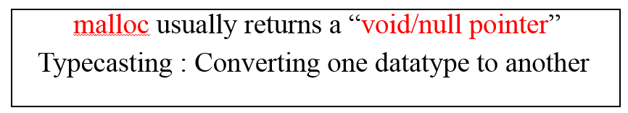
Static & Dynamic arrays
Static array - created in stack memory
eg. int A[3];
Dynamic array - created in heap memory
- create a pointer variable - created in stack memory
- use dynamic memory allocation functions (malloc,calloc)
eg. int *P;
int * P = malloc(3 * sizeof(int)); //3 is the size of array
int * P = (int *)malloc(3 * sizeof(int)); //returns the starting address of array

Slide 5
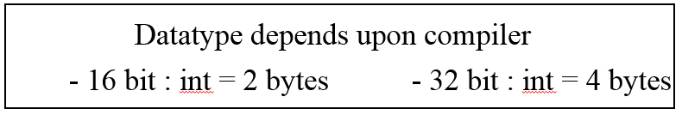
Memory allocation for an array
Memory is contiguously allocated for every subsequent numbers
(data in the memory becomes structured /organized – Data Structure)
Any array is accessed using its index (starting with 0)
Reason for 0 index :
Formula = address of 1st block + sizeof(datatype of corresponding array) * index number)

Slide 6
Explanation contd…
Consider array A[5] with indices : 1000,1002,1004,1006,1008
eg. 1000+2 * 1 = 1002 (2nd index)
1000+2 * 0 = 1000 (1st index)
Address is always a unique 16 bit hexadecimal no.

Slide 7
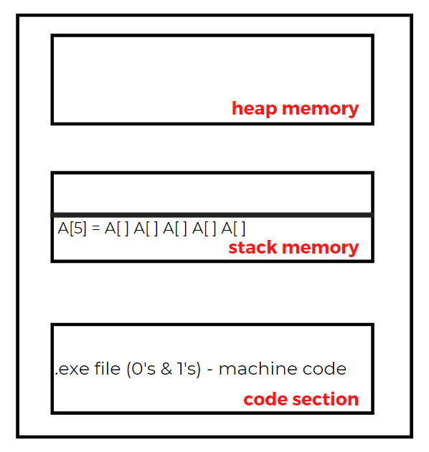
Backend progress
Dynamic array
Whenever a function is invoked , corresponding
activation area is created in stack memory
In C, (default) activation area = main()
200
activation area
int *P;
Static array

Slide 8
Passing array into functions
An entire array can be passed into a function
In function call, the array must be passed only by the array name as an actual argument
Array, when passed as an formal argument, should be followed by empty square brackets “[ ]”
eg. Consider an array : int A[3] = {1,2,3};
Passing array as formal argument : int add(int A[ ]);

Slide 9
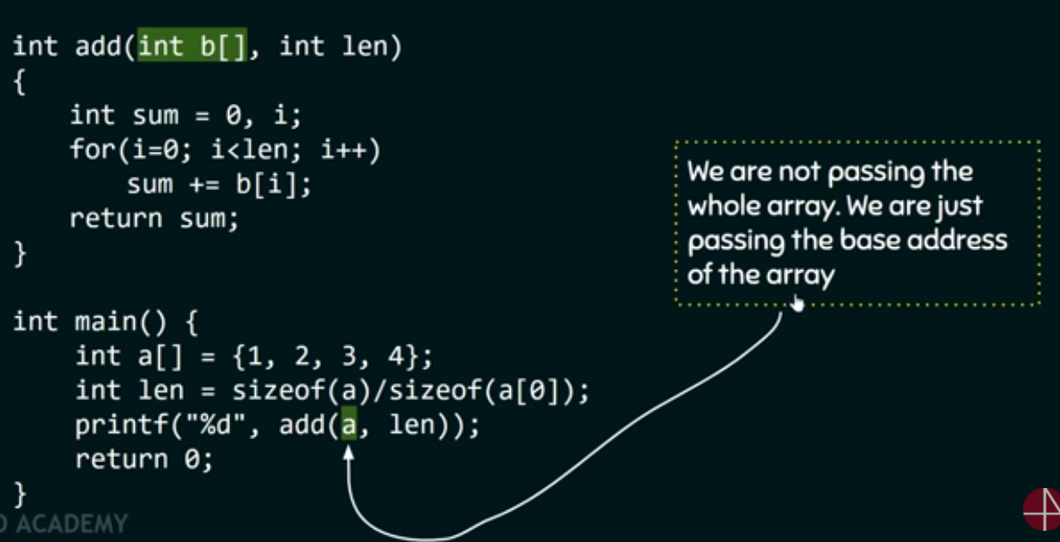
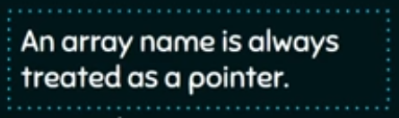
Example

Slide 10
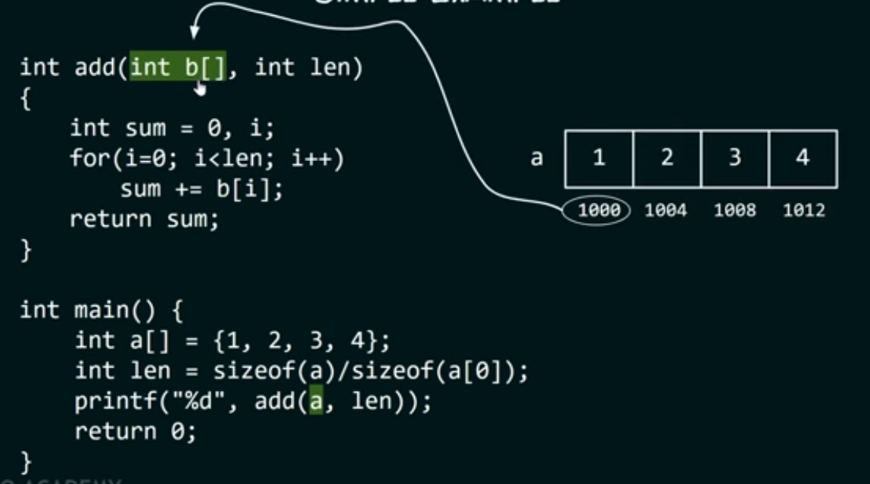

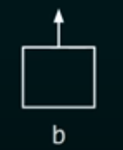
Output : 10

Slide 11
Possible array declarations
int A[5]; // 1d array
int A[2][3]; // 2d array
int A[ ][3]; // It is important to specify the second dimension

Slide 12
2d array
Syntax : data_type array_name[x][y]; //x , y are array sizes
eg. int A[3][4]; //3 rows & 4 columns
Initializing 2d array :
Method 1 : int A[2][3] = {1,2,3,4,5,6};
Method 2 : int A[2][3] = {{1,2,3},{4,5,6}};
Accessing 2d array :
Using row and column index
Printing a 2d array :
Using 2 for loops //1 for row & 1 for column

Slide 13
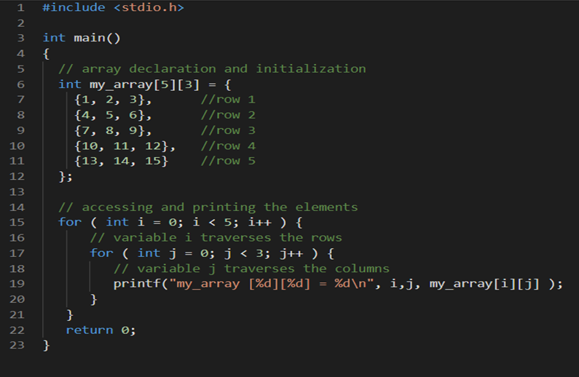
Example
Output :
my_array [0][0] = 1
my_array [0][1] = 2
my_array [0][2] = 3
my_array [1][0] = 4
my_array [1][1] = 5
my_array [1][2] = 6
my_array [2][0] = 7
my_array [2][1] = 8
my_array [2][2] = 9
my_array [3][0] =10
my_array [3][1] =11
my_array [3][2] =12
my_array [4][0] =13
my_array [4][1] =14
my_array [4][2] =15
0
1
2
0
1 | 2 | 3
4 | 5 | 6
7 | 8 | 9
10 | 11 | 12
13 | 14 | 15
1
2
3
4

Slide 14
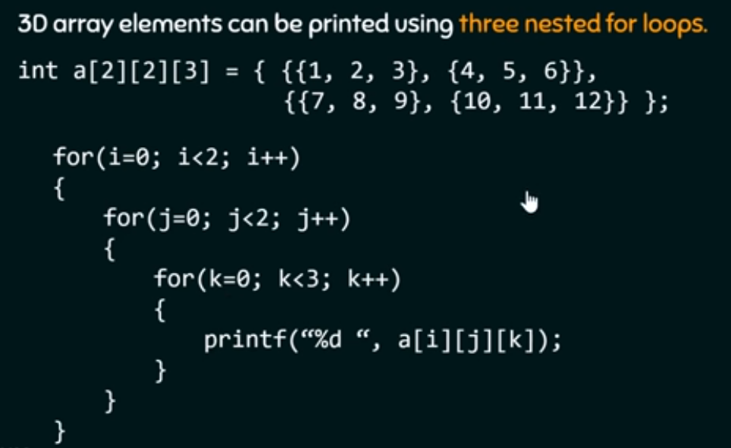
3d array
Here, we need 2
2d arrays of size [2][3]
int a[2][2][3];
where
1st 2 denotes the number of 2d arrays
2nd 2 denotes the number of rows
3rd 3 denotes the number of columns

Slide 15
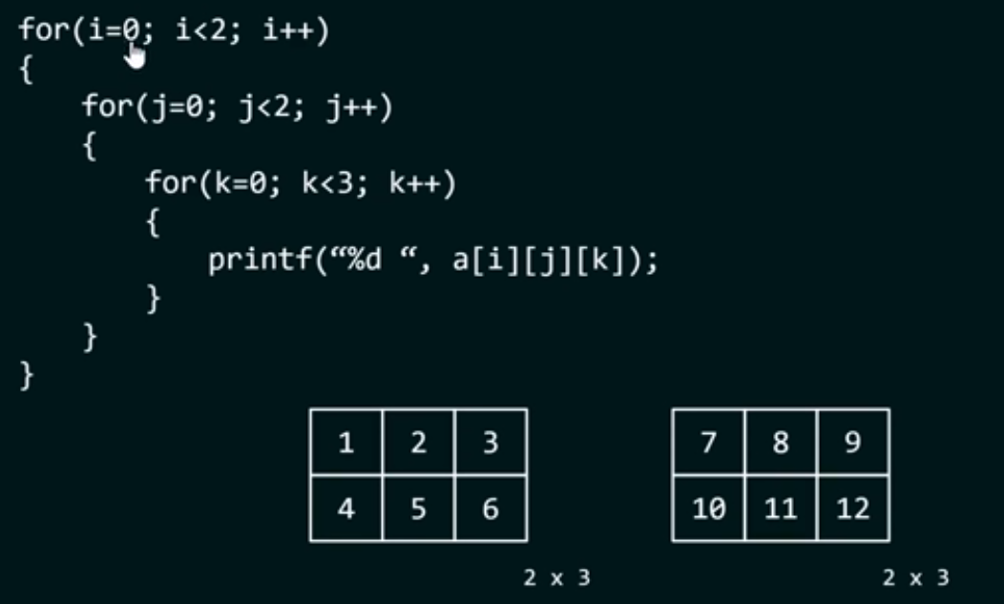
Printing 3d arrays
0
1
2
0
1
2
0
0
1
1

Slide 16
Multidimensional arrays
Array of arrays
Same as one-dimensional arrays, except that it requires
separate pair of square brackets for each subscript
Syntax : storage-class data_type array_name[size 1] [size 2]…[size n];
Size of multidimensional array can be calculated by multiplying all dimensions

Slide 17
Thank you!

